Slide 1

Solving Simple Equations
Substituting in an Expression
Given: $a=−5;b=2;c=3$ , solve the following
$3a^{2}−2b+c$
$=3{\left(−5\right)}^{2}−2\left(2\right)+3$
$=3\left(25\right)−4+3$
$=74$
$\frac{a^{3}+c^{4}}{3c+2a}$
$=\frac{{\left(−5\right)}^{3}+{\left(3\right)}^{4}}{3\left(3\right)+2\left(−5\right)}$
$=\frac{−125+81}{9−10}$
$=\frac{−44}{−1}$
$=44$

Slide 2




Given: $x=\frac{5}{8};y=−\frac{3}{7};z=2\frac{4}{9}$
$6yz=6\left(\frac{22}{9}\right)\left(−\frac{3}{7}\right)$
$=\frac{44}{3}\left(−\frac{3}{7}\right)$
$=−\frac{44}{7}=−6\frac{2}{7}$
$\frac{4xy}{3z}=\frac{4\left(\frac{5}{8}\right)\left(−\frac{3}{7}\right)}{3\left(\frac{22}{9}\right)}=\frac{\left(\frac{5}{2}\right)\left(−\frac{3}{7}\right)}{\frac{22}{9}}$
$=\frac{−15}{14}×\frac{3}{22}$
$=−\frac{45}{308}$
$\frac{−\frac{4}{5}x+3z}{7y+z}=\frac{−\frac{4}{5}\left(\frac{5}{8}\right)+3\left(\frac{22}{9}\right)}{7\left(−\frac{3}{7}\right)+\frac{22}{9}}=\frac{−\frac{1}{2}+\frac{22}{3}}{−3+\frac{22}{9}}$
$=\frac{\frac{41}{6}}{−\frac{5}{9}}$
$=\frac{41}{6}×−\frac{9}{5}$
$=−\frac{369}{30}=−12\frac{9}{30}$

Slide 3
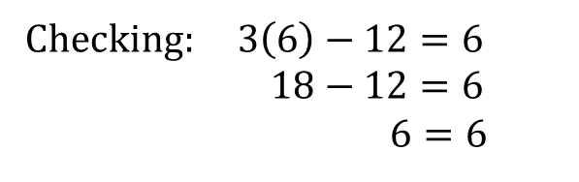
Solving Equations
$3x−12=6$
$3x=6+12$
$3x=18$
$∴x=\frac{18}{3}=6$
$15x+5=9x−1$
$15x−9x=−1−5$
$6x=−6$
$∴x=−\frac{6}{6}=−1$
Checking: $3\left(6\right)−12=6$
$18−12=6$
$6=6$

Slide 4
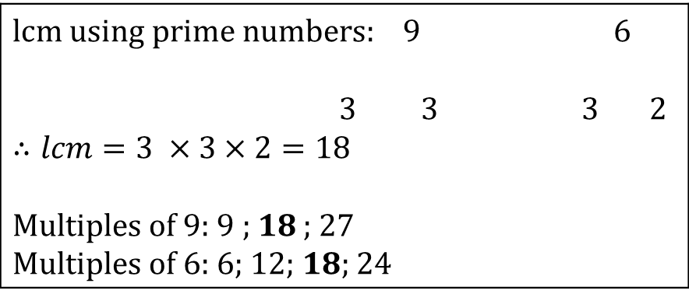
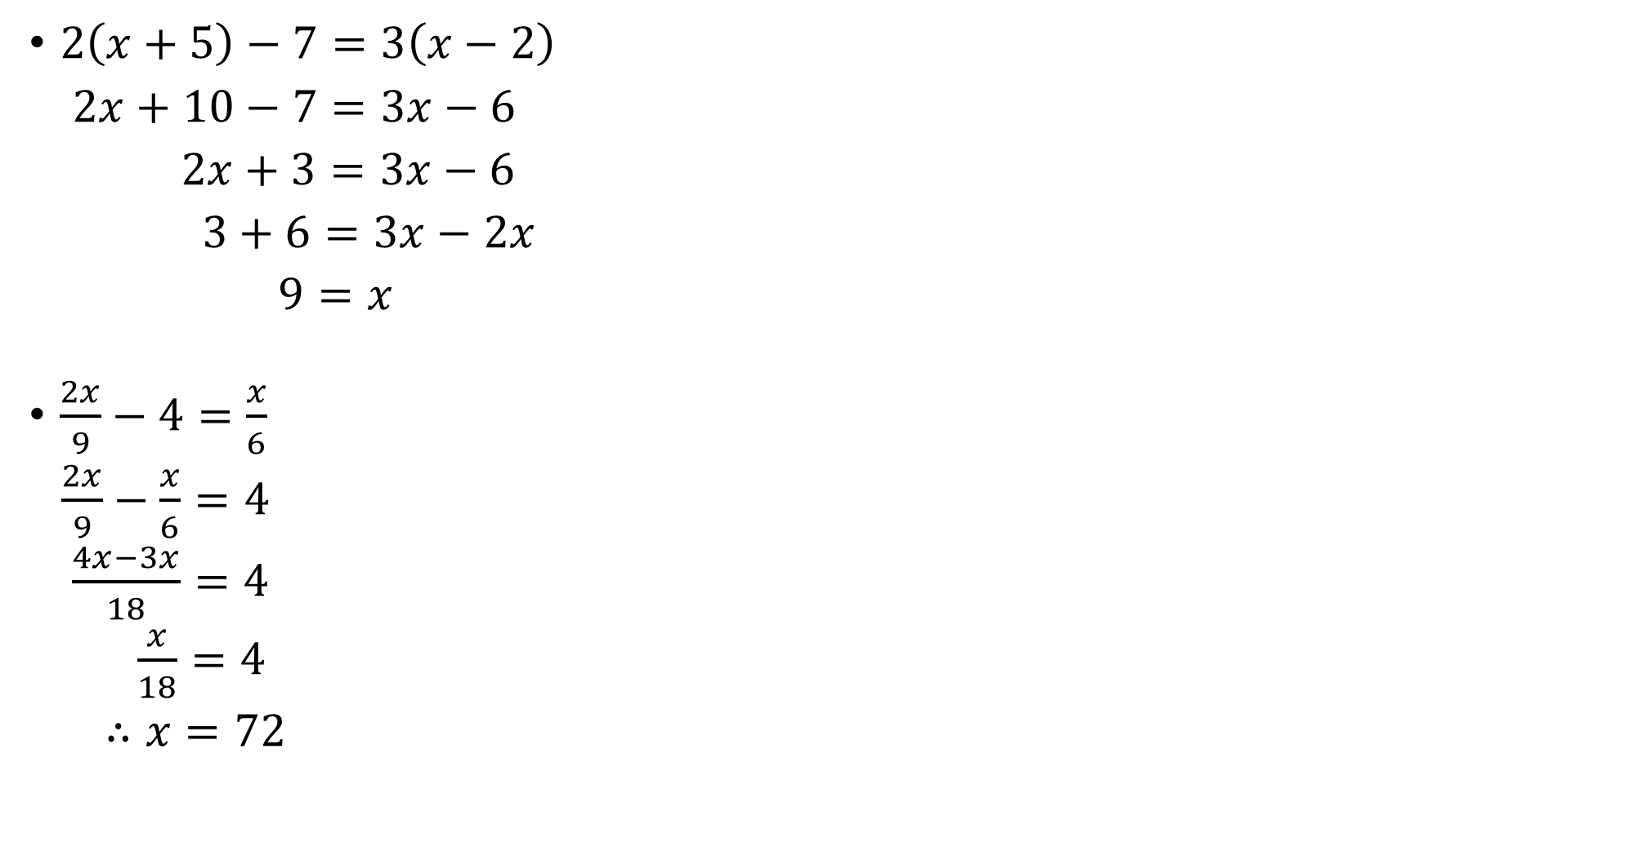
Solving Equations
$2\left(x+5\right)−7=3\left(x−2\right)$
$2x+10−7=3x−6$
$2x+3=3x−6$
$3+6=3x−2x$
$9=x$
$\frac{2x}{9}−4=\frac{x}{6}$
$\frac{2x}{9}−\frac{x}{6}=4$
$\frac{4x−3x}{18}=4$
$\frac{x}{18}=4$
$∴x=72$
lcm using prime numbers: $9$ 6 3 3 3 2 $∴lcm=3 ×3×2=18$ Multiples of 9: 9 ; 18 ; 27 Multiples of 6: 6; 12; 18; 24

Slide 5

Solving Equations
$\frac{2}{3}x+\frac{3}{4}\left(36−2x\right)=32$
$\frac{2x}{3}+\frac{108}{4}−\frac{6x}{4}=32$
$\frac{2x}{3}−\frac{3x}{2}=32−27$
$\frac{4x−9x}{6}=5$
$\frac{−5x}{6}=5$
$−5x=30$
$∴x=\frac{−30}{5}$
$=−6$

Slide 6
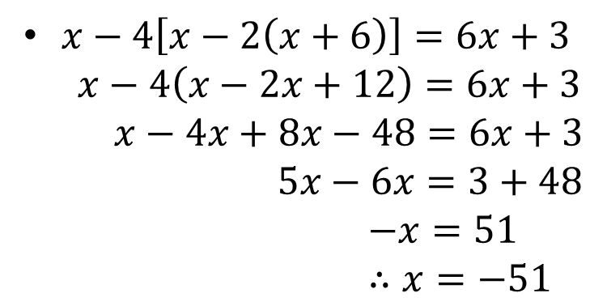
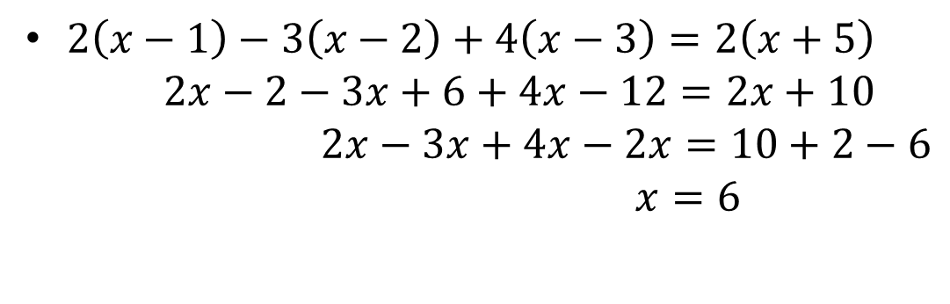
$2\left(x−1\right)−3\left(x−2\right)+4\left(x−3\right)=2\left(x+5\right)$
$2x−2−3x+6+4x−12=2x+10$
$2x−3x+4x−2x=10+2−6$
$x=6$
$x−4\left[x−2\left(x+6\right)\right]=6x+3$
$x−4\left(x−2x+12\right)=6x+3$
$x−4x+8x−48=6x+3$
$5x−6x=3+48$
$−x=51$
$∴x=−51$

Slide 7
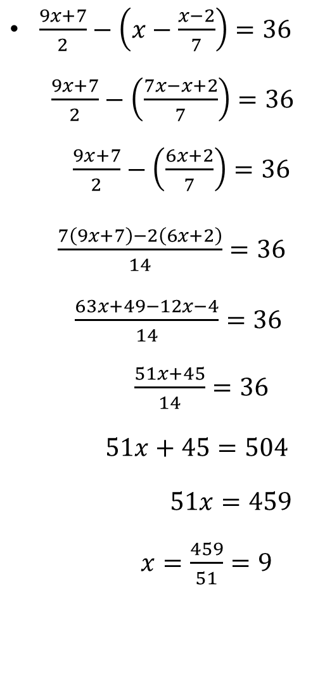
$\frac{9x+7}{2}−\left(x−\frac{x−2}{7}\right)=36$
$\frac{9x+7}{2}−\left(\frac{7x−x+2}{7}\right)=36$
$\frac{9x+7}{2}−\left(\frac{6x+2}{7}\right)=36$
$\frac{7\left(9x+7\right)−2\left(6x+2\right)}{14}=36$
$\frac{63x+49−12x−4}{14}=36$
$\frac{51x+45}{14}=36$
$51x+45=504$
$51x=459$
$x=\frac{459}{51}=9$

Slide 8
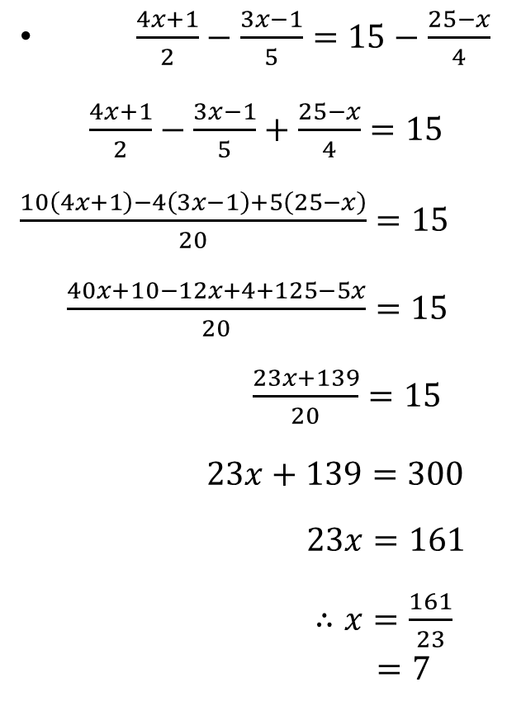
$\frac{4x+1}{2}−\frac{3x−1}{5}=15−\frac{25−x}{4}$
$\frac{4x+1}{2}−\frac{3x−1}{5}+\frac{25−x}{4}=15$
$\frac{10\left(4x+1\right)−4\left(3x−1\right)+5\left(25−x\right)}{20}=15$
$\frac{40x+10−12x+4+125−5x}{20}=15$
$\frac{23x+139}{20}=15$
$23x+139=300$
$23x=161$
$∴x=\frac{161}{23}$
$=7$

Slide 9
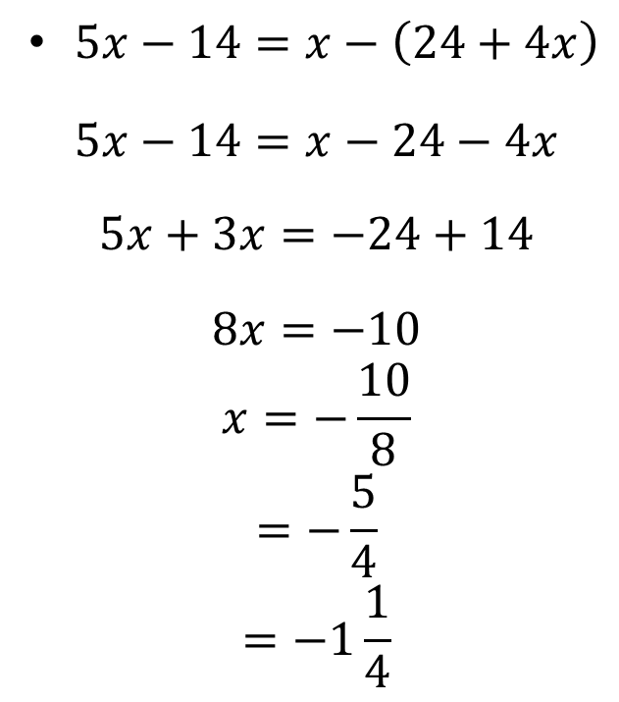
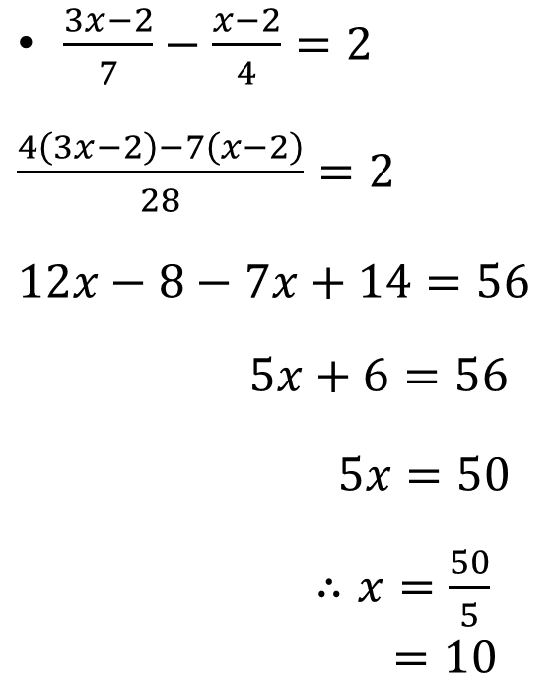
$\frac{3x−2}{7}−\frac{x−2}{4}=2$
$\frac{4\left(3x−2\right)−7\left(x−2\right)}{28}=2$
$12x−8−7x+14=56$
$5x+6=56$
$5x=50$
$∴x=\frac{50}{5}$
$=10$
$5x−14=x−\left(24+4x\right)$
$$5x−14=x−24−4x$$
$$5x+3x=−24+14$$
$$8x=−10$$
$$x=−\frac{10}{8}$$
$$=−\frac{5}{4}$$
$$=−1\frac{1}{4}$$

Slide 10
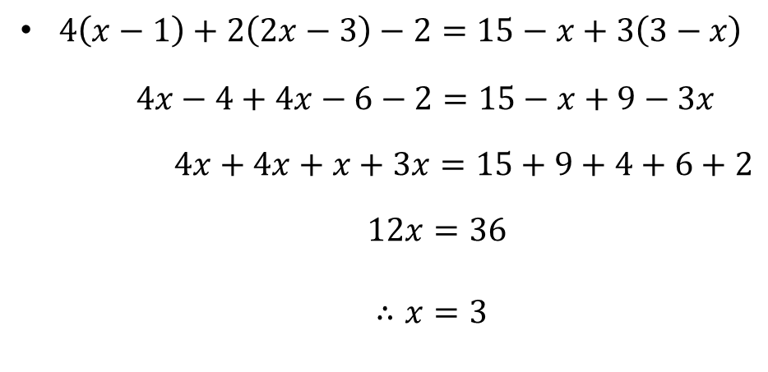
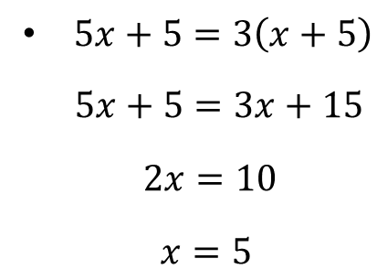
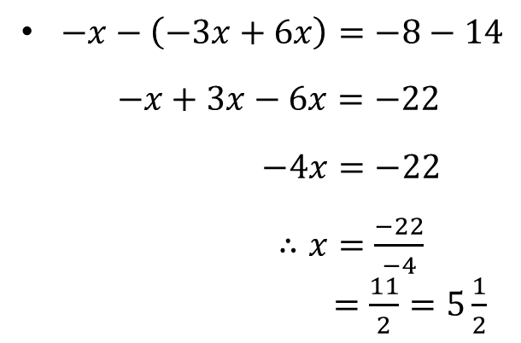
$5x+5=3\left(x+5\right)$
$5x+5=3x+15$
$2x=10$
$x=5$
$4\left(x−1\right)+2\left(2x−3\right)−2=15−x+3\left(3−x\right)$
$4x−4+4x−6−2=15−x+9−3x$
$4x+4x+x+3x=15+9+4+6+2$
$12x=36$
$∴x=3$
$−x−\left(−3x+6x\right)=−8−14$
$−x+3x−6x=−22$
$−4x=−22$
$∴x=\frac{−22}{−4}$
$=\frac{11}{2}=5\frac{1}{2}$

Slide 11


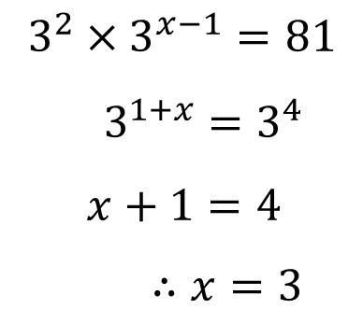
$2×4^{x−1}=8^{−x}$
$2×2^{2\left(x−1\right)}=2^{3\left(−x\right)}$
$2×2^{2x−2}=2^{−3x}$
$2^{2x−1}=2^{−3x}$
$2x−1=−3x$
$2x+3x=1$
$5x=1∴x=\frac{1}{5}$
$$3^{2}×3^{x−1}=81$$
$3^{1+x}=3^{4}$
$x+1=4$
$∴x=3$
${81}^{x}×9^{3−x}=3^{−x}$
$3^{4x}×3^{2\left(3−x\right)}=3^{−x}$
$3^{4x}×3^{6−2x}=3^{−x}$
$3^{2x+6}=3^{−x}$
$2x+6=−x$
$3x=−6$
$∴x=−2$

Slide 12
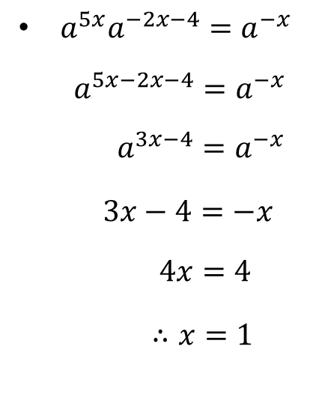
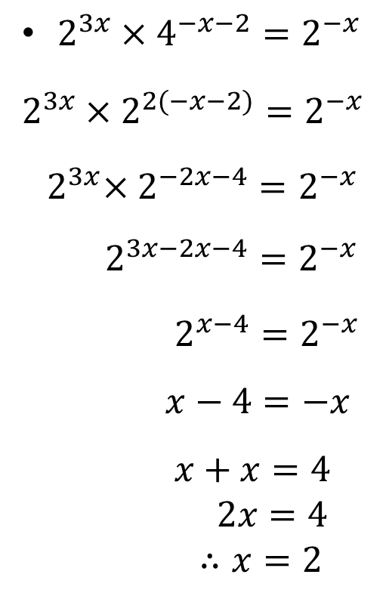
$2^{3x}×4^{−x−2}=2^{−x}$
$2^{3x}×2^{2(−x−2)}=2^{−x}$
${ 2}^{3x}×2^{−2x−4}=2^{−x}$
$2^{3x−2x−4}=2^{−x}$
$2^{x−4}=2^{−x}$
$x−4=−x$
$x+x=4$
$2x=4$
$∴x=2$
$a^{5x}a^{−2x−4}=a^{−x}$
$a^{5x−2x−4}=a^{−x}$
$a^{3x−4}=a^{−x}$
$3x−4=−x$
$4x=4$
$∴x=1$

Slide 13


Changing the subject of the formulae
$y=7x−5$
$y+5=7x$
$∴x=\frac{y+5}{7}$
$y=\frac{1}{2}x−7$
$y+7=\frac{x}{2}$
$∴x=2\left(y+7\right)$
$=2y+14$
$y=\frac{1}{2x+1}$
$y\left(2x+1\right)=1$
$2xy+y=1$
$2xy=1−y$
$∴x=\frac{1−y}{2y}$

Slide 14

Changing the subject of the formulae
$y=x\left(1+\frac{1}{x}\right)$
$=x+1$
$∴x=y−1$
$y=\frac{x^{2}}{2g}$
$2gy=x^{2}$
$∴x=\sqrt{2gy}$

Slide 15

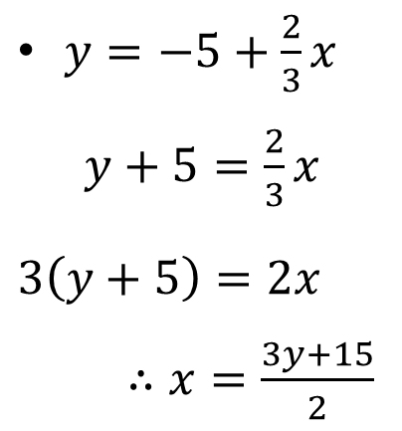
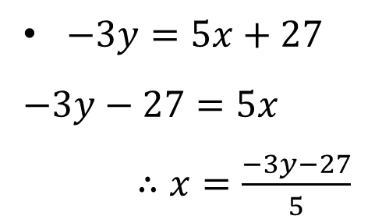
$y=−5+\frac{2}{3}x$
$y+5=\frac{2}{3}x$
$3\left(y+5\right)=2x$
$∴x=\frac{3y+15}{2}$
$y=15+5x$
$y−15=5x$
$∴x=\frac{y−15}{5}$
$=\frac{y}{5}−3$
$−3y=5x+27$
$−3y−27=5x$
$∴x=\frac{−3y−27}{5}$

Slide 16

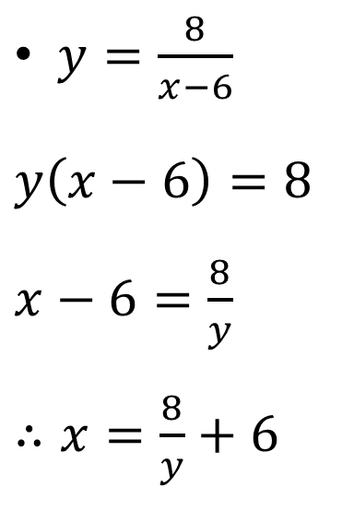
$y=\frac{8}{x−6}$
$y\left(x−6\right)=8$
$x−6=\frac{8}{y}$
$∴x=\frac{8}{y}+6$
$y=1+\frac{2}{3}x$
$y−1=\frac{2}{3}x$
$3y−3=2x$
$∴x=\frac{3}{2}y−\frac{3}{2}$

Slide 17
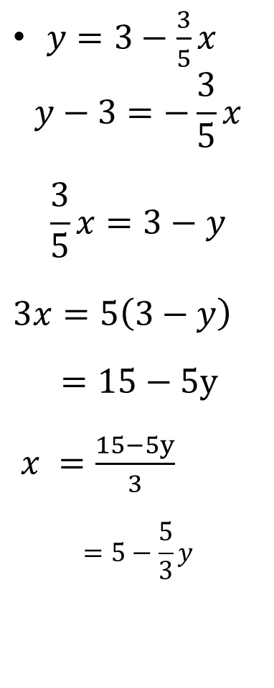
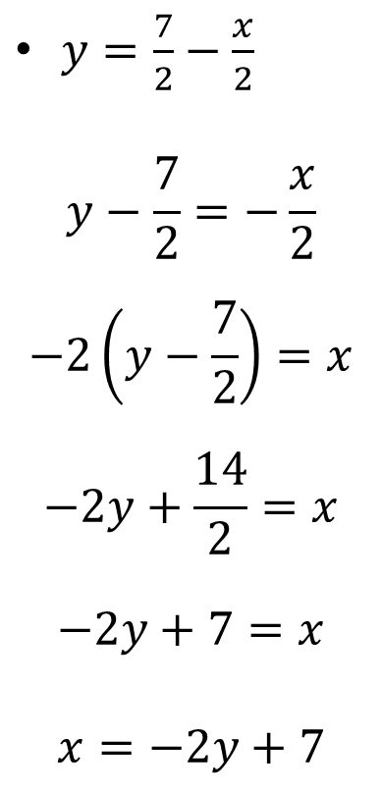
$y=\frac{7}{2}−\frac{x}{2}$
$$y−\frac{7}{2}=−\frac{x}{2}$$
$$−2\left(y−\frac{7}{2}\right)=x$$
$$−2y+\frac{14}{2}=x$$
$$−2y+7=x$$
$$x=−2y+7$$
$y=3−\frac{3}{5}x$
$$y−3=−\frac{3}{5}x$$
$$\frac{3}{5}x=3−y$$
$3x=5\left(3−y\right)$
$=15−5y$
$x =\frac{15−5y}{3}$
$$=5−\frac{5}{3}y$$

Slide 18



$y=13x−18$
$y+18=13x$
$\frac{y+18}{13}=x$
$y=\frac{13}{x}+18$
$y−18=\frac{13}{x}$
$x(y−18)=\frac{13}{x}$
$∴x=\frac{13}{y−18}$
$y=\frac{13}{x+18}$
$xy+18y=13$
$xy=13−18y$
$∴x=\frac{13}{y}−\frac{18y}{y}$
$=\frac{13}{y}−18$

Slide 19
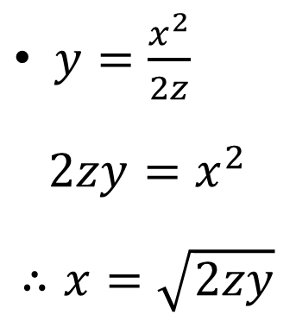
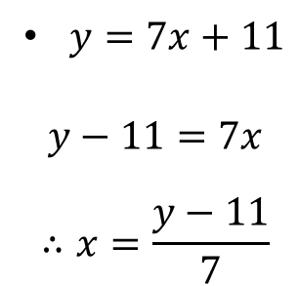
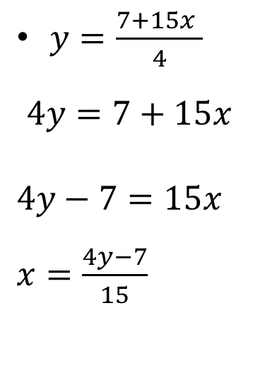
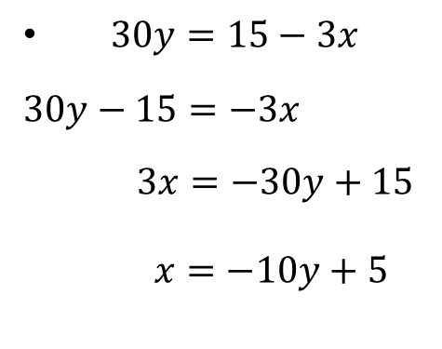
$y=7x+11$
$$y−11=7x$$
$$∴x=\frac{y−11}{7}$$
$30y=15−3x$
$30y−15=−3x$
$3x=−30y+15$
$x=−10y+5$
$y=\frac{x^{2}}{2z}$
$$2zy=x^{2}$$
$$∴x=\sqrt{2zy}$$
$y=\frac{7+15x }{4}$
$$4y=7+15x$$
$4y−7=15x$
$x=\frac{4y−7}{15}$

